Slide 1
LIMIT Clause
- Morshedul Arefin

Slide 2
LIMIT Clause
LIMIT clause that is used to specify the number of records to return.
Example:
$statement = $conn->prepare("SELECT * FROM students LIMIT 3");
$statement->execute();
$result = $statement->fetchAll(PDO::FETCH_NUM);

Slide 3
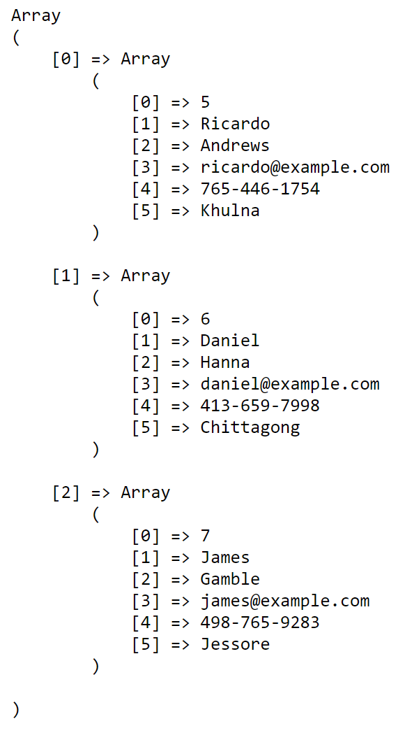
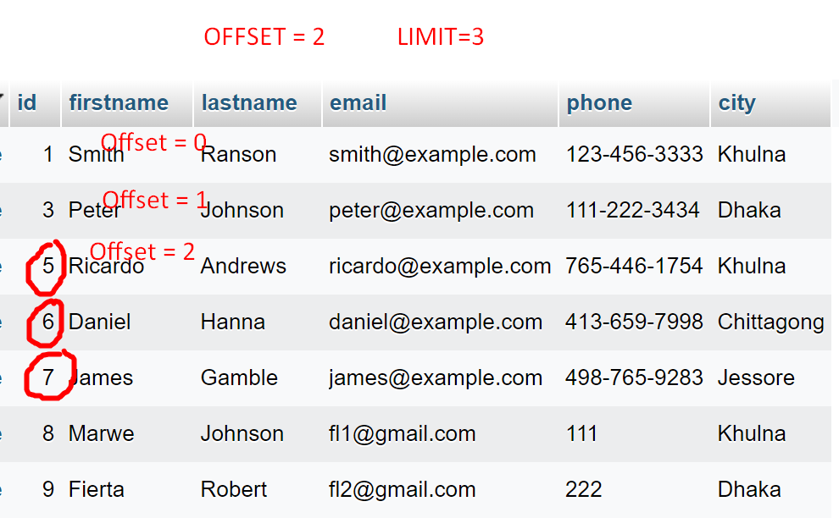
LIMIT Clause (…)
$statement = $conn->prepare("SELECT * FROM students
LIMIT 3 OFFSET 2");
OR
$statement = $conn->prepare("SELECT * FROM students LIMIT 2, 3");
$statement->execute();
$result = $statement->fetchAll(PDO::FETCH_NUM);

